Slide 1
L-Ergothioneine
&
Epigenetic Aging
A Randomized Trial Proposal
Michael Barrow mjbarrow@stanford.edu

Slide 2
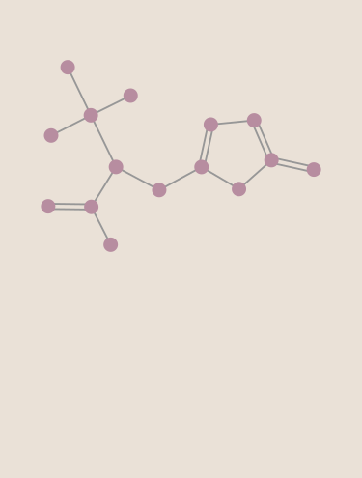
What Is L-Ergothioneine (EGT)?
A sulfur-containing amino acid you can only get from food
Unlike glutathione or vitamin C it resists autoxidation
The L-Ergothioneine molecule in its prettiest conformation*
Notes:
Generally recognized as safe
100 years to understand the cell bio

Slide 3
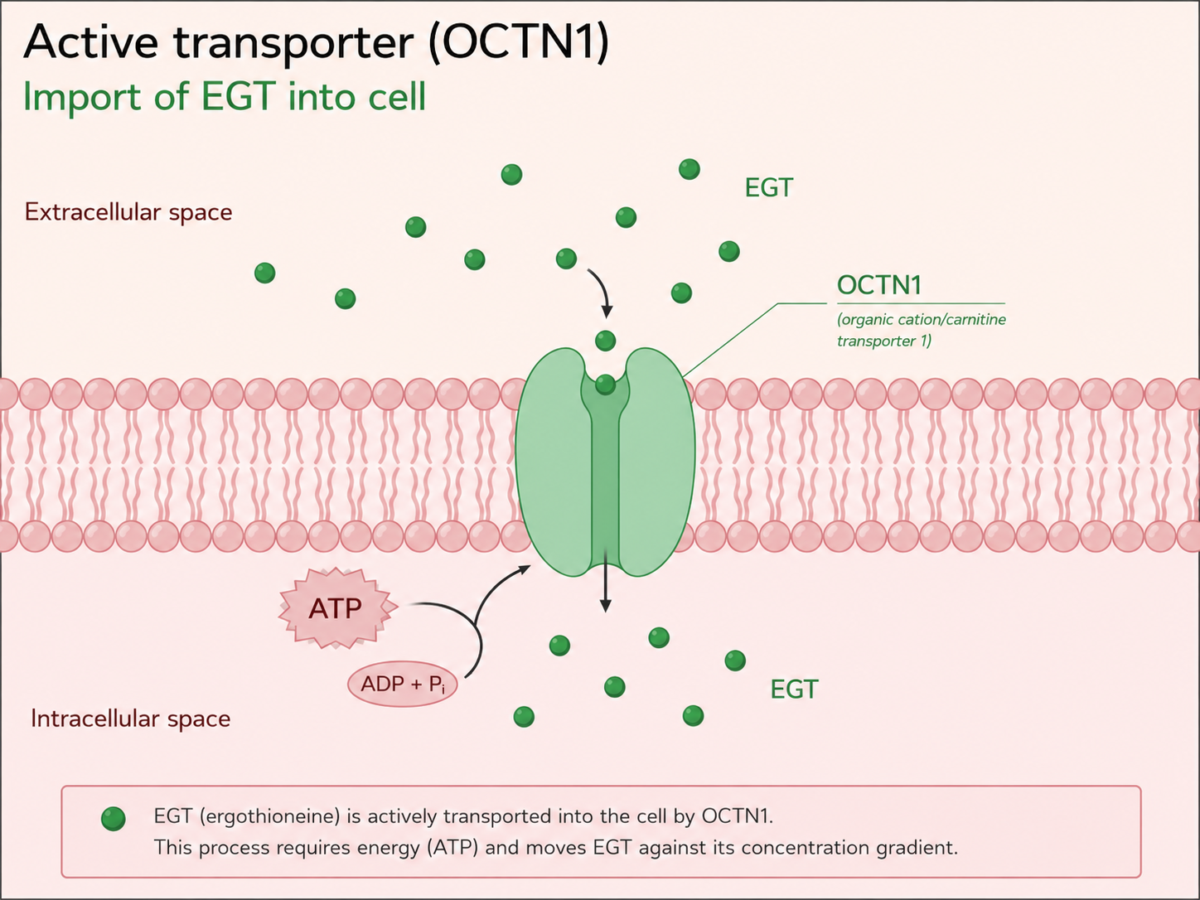
How the Body Handles EGT
OCTN1 Dedicated transporter with EGT specific affinity
Pumps up to 1000x plasma concentration into cells
Conserved across mammals, birds, and fish
Notes:
Generally recognized as safe
100 years to understand the cell bio

Slide 4
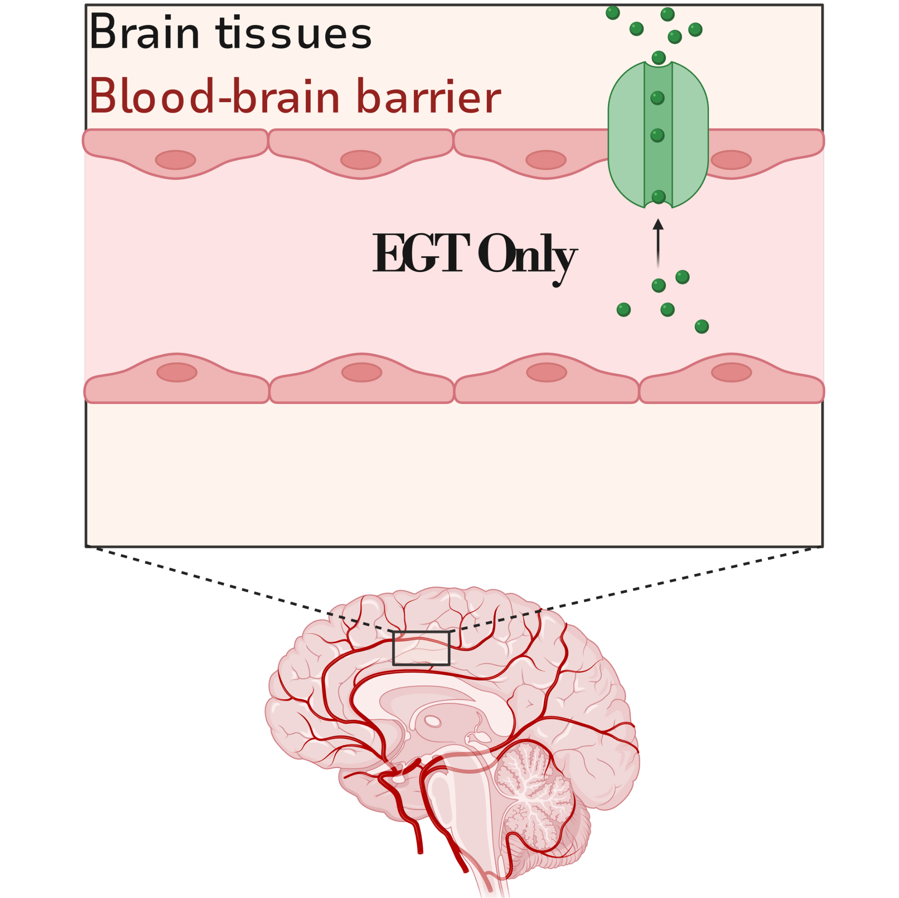
Where EGT Goes and Why it Matters
Concentrated in age sensitive cells
Liver, kidney, skin, brain, erythrocytes
Crosses the blood-brain barrier
Accumulates in mitochondria
Dietary amino acid + Dedicated Transporter + GRAS
A Rare combination for long term trial
Notes:
Generally recognized as safe
100 years to understand the cell bio

Slide 5
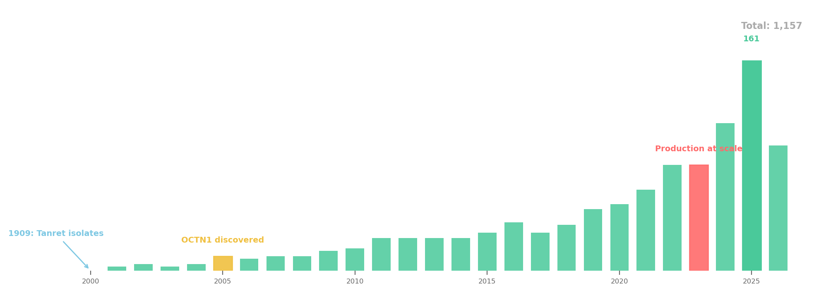
Brief History of EGT Research
2022*
Commercial culturing
Developed
1909
EGT Isolated by
Charles Tennent
2017
Cheah
Establishes safety of oral supplementation
EGT PubMed Articles over time
1596
EGT rich tonics
Catalogued in
Bencao Gangmu
2005
OCTN1 Active Transporter Identified by Grundemann
2025
Zajac’s 16 week RCT on Cognitive function
Notes:
Next we move on to what we have found this past several hundred years with a particular focus on the past 20 years Zajac, Ian T., et al. "The effect of ergothioneine supplementation on cognitive function, memory, and sleep in older adults with subjective memory complaints: a randomized placebo-controlled trial." Nutraceuticals 5.3 (2025): 15.

Slide 6
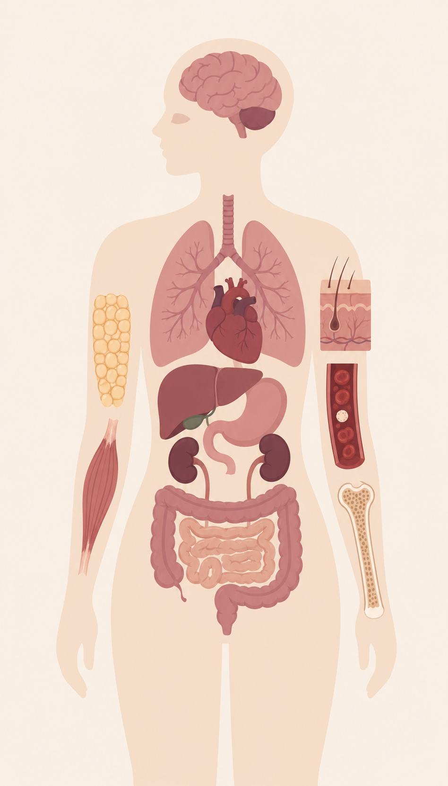
Mechanisms: Cell Bio Studies
Eye: 13
Brain/CNS: 107
Lung: 15
Adipose / Metabolic: 63
Skin: 27
Liver: 25
Heart / CV: 32
Kidney: 16
Blood / Immune: 39
Muscle: 21
Gut: 33
Bone / Joint: 11
Hundreds of in vitro studies explore EGT mechanisms in cellular biology
Notes:
Next we look at some mechanistic studies, can we explain each of the observations?

Slide 7
Outcomes: Human Studies
Mortality / Survival | 3
Cardiovascular | 2
Cognitive / Neurodegeneration | 8
Physical Function / Frailty | 2
Aging / Senescence | 2
Nutrition / Dietary | 6
Cognitive / Brain | 1
Metabolic / Diabetes | 1
Ovarian / Reproductive | 1
PubMed: Observational Studies
PubMed: Interventional (RCT)
Notes:
First we look at observational studies, these are some RCTs on supplementation
Note, RCTs tend to be small and short
Epidemiological tend to be larger and longer
Nothing Epidemiological prior to 2020, RCT earliest is 2022

Slide 8
Mechanisms: Geroprotective Greatest Hits
Gao 2025: Neuroprotection (Parkinson's model)
EGT reduces α-synuclein aggregation, protects dopaminergic neurons
Sprenger 2025: First direct molecular target (Cell Metabolism)
EGT directly binds and activates MPST, boosting mitochondrial respiration
D'Onofrio 2016: SIRT6 causal proof (Free Radic Biol Med)
0.5mM EGT prevents endothelial senescence; SIRT6 silencing abolishes entirely
Kim 2017: Corneal endothelial protection (IOVS)
EGT protects against UPR and oxidative stress in corneal cells
Li 2024: Antioxidant mechanism (Clin Cosmet Investig Dermatol)
PI3K/AKT/Nrf2 pathway activation against UV-induced oxidative damage
Notes:
Next we look at some mechanistic studies, can we explain each of the observations?

Slide 9
Human Outcome Studies: Geroprotective Greatest Hits
Smith et al. 2020: Malmö Diet & Cancer Study (N=3,236, 21yr)
21% lower CV mortality (HR 0.79, p=0.002), 14% lower all-cause (HR 0.86, p=4e-5)
Yau et al. 2024: EGT-Mild Cognitive Impairment (MCI) Pilot (1yr, MCI patients)
Cognitive stabilization, improved learning/memory (AVLT), safe at 1 year
Katsube et al. 2022: Sleep RCT (20mg/day, 4wk)
Improved PSQI, increased deep sleep (EEG N2 stage), decreased waking after onset
Hseu 2020, Ko 2021, Li 2024: Dermatological studies
EGT protects against UVA/UVB photoaging via Nrf2/HO-1 and PI3K/AKT pathways
Notes:
First we look at observational studies, these are some RCTs on supplementation

Slide 10
Geroprotective Taxonomy: The Gap
EGT demonstrates potential in major branches of cellular longevity research
Taxonomy of Longevity Endpoints |  |  |  | Academic Study
Oxidative Stress |  |  |  | [5,7,8]
 | Telomere Attrition |  |  | [1]
 | Epigenetic Drift |  |  | Our Proposal
 |  | Mitochondrial Redox |  | [9,10,11]
 |  |  | Sensescence Escape | [2,3,4,6]
 | Proteostasis / UPR |  |  | [12,13,14]
Notes:
Now a gap, can we demonstrate geroprotection more broadly?
[1] Samuel P, Tsapekos M, de Pedro N, Liu AG, Casey Lippmeier J, Chen S. Ergothioneine mitigates telomere shortening under oxidative stress conditions. Journal of Dietary Supplements. 2022 Mar 4;19(2):212-25
[2] Apparoo Y, Phan CW, Kuppusamy UR, Chan EW. Potential role of ergothioneine rich mushroom as anti-aging candidate through elimination of neuronal senescent cells. Brain research. 2024 Feb 1;1824:148693.
[3] Ko HJ, Kim J, Ahn M, Kim JH, Lee GS, Shin T. Ergothioneine alleviates senescence of fibroblasts induced by UVB damage of keratinocytes via activation of the Nrf2/HO-1 pathway and HSP70 in keratinocytes. Experimental Cell Research. 2021 Mar 1;400(1):112516.
[4] D’Onofrio N, Servillo L, Giovane A, Casale R, Vitiello M, Marfella R, Paolisso G, Balestrieri ML. Ergothioneine oxidation in the protection against high-glucose induced endothelial senescence: involvement of SIRT1 and SIRT6. Free Radical Biology and Medicine. 2016 Jul 1;96:211-22.
[5]Li Y, Gao J, Liu S, Chen S, Wei X, Guan Y, Li X, Li Y, Huang Z, Li G, Zhao Y. Ergothioneine protects against UV-induced oxidative stress through the PI3K/AKT/Nrf2 signaling pathway. Clinical, Cosmetic and Investigational Dermatology. 2024 Dec 31:1309-19.
[6] Yasaaswini A. Studies on the protective effects of ergothioneine-rich mushroom extract against stress-induced premature senescence (SIPS) in neuronal cells/Yasaaswini Apparoo (Doctoral dissertation, Universiti Malaya).
[7] Servillo L, Castaldo D, Casale R, D’Onofrio N, Giovane A, Cautela D, Balestrieri ML. An uncommon redox behavior sheds light on the cellular antioxidant properties of ergothioneine. Free Radical Biology and Medicine. 2015 Feb 1;79:228-36.
[8] Gao W, Wang Y, Wang F, Wu X, Lu F, Liu F. Ergothioneine exerts neuroprotective effects in Parkinson’s disease: Targeting α-synuclein aggregation and oxidative stress. Food Research International. 2025 Feb 1;201:115590.
[9] Paul BD, Snyder SH. The unusual amino acid L-ergothioneine is a physiologic cytoprotectant. Cell Death & Differentiation. 2010 Jul;17(7):1134-40.
[10] Fong ZW, Tang RM, Cheah IK, Leow DM, Chen L, Halliwell B. Ergothioneine and mitochondria: An important protective mechanism?. Biochemical and Biophysical Research Communications. 2024 Sep 24;726:150269.
[11] Apparoo Y, Phan CW, Kuppusamy UR, Chiang EC. Ergothioneine-rich Lentinula edodes mushroom extract restores mitochondrial functions in senescent HT22 cells. Neuroscience. 2025 Jan 26;565:277-91.
[12] Yau YF, Cheah IK, Mahendran R, Tang RM, Chua RY, Goh RE, Feng L, Li J, Kua EH, Chen C, Halliwell B. Investigating the efficacy of ergothioneine to delay cognitive decline in mild cognitively impaired subjects: A pilot study. Journal of Alzheimer’s Disease. 2024 Dec;102(3):841-54.
[13] Tng TJ, Leow DM, Goh G, Wang Z, Liu Y, Tang RM, Lai KC, Basil AH, Choong HC, Goh WW, Cheah IK. Ergothioneine Treatment Ameliorates the Pathological Phenotypes of Parkinson's Disease Models. Journal of Neurochemistry. 2025 Jul;169(7):e70168.
[14] Kim EC, Toyono T, Berlinicke CA, Zack DJ, Jurkunas U, Usui T, Jun AS. Screening and characterization of drugs that protect corneal endothelial cells against unfolded protein response and oxidative stress. Investigative ophthalmology & visual science. 2017 Feb 1;58(2):892-900.

Slide 11
Proposal: RCT on Oral EGT Supplementation
Hypothesis:
30 mg/day ergothioneine for 12 months slows epigenetic aging measured using DNA clocks, with parallel improvements in functional aging endpoints, providing the first causal test of EGT's geroprotective potential in humans.
Primary | Do DNA clocks demonstrate reduced biological age over 12-18 months?
Mechanistic | Do blood biomarkers evidence bioavailability and EGT mediated changes?
Functional | Do functional assessments detect changes in aging trajectory?
Exploratory | Are there correlations between DNA clock and functional outcomes?
Specific aims of a 12-18 month study
Notes:
How could we close the gap with a study?
We combine two hypothetically low risk types of end point.
Firstly, Epidemiological cognitive evidence which has been shown in several studies
Secondly, epigenetic drift evidence which has not been explored
In concert these end points provide compelling geroprotective evidence by combining quantitive antiaging measures with empirically observed improvements in age related pathology

